Slide 1
STATISTICAL FOUNDATIONS FOR MACHINE LEARNING
Hypothesis Testing and Regression Analysis
Course: Foundations of Data Analysis (Group A)
Mediacrest Training College
Trainer: Victor Lumumba Wandera
Date: 9th Feb 2026-11th Feb 2026
Dataset: Hypertension Clinical Cohort (htn_dat.csv)
Bridge Module to Week 3 Machine Learning

Slide 2
Why Statistics Before Machine Learning?
Machine Learning is applied statistics at scale.
Key statistical foundations:
Hypothesis testing for decision-making
Regression for prediction and inference
p-values and confidence intervals for uncertainty
Healthcare relevance in Kenya:
Logistic regression for hypertension risk prediction
Survival analysis for HIV treatment outcomes
Statistics ensures transparent and responsible AI
Key message:
Machine learning without statistics becomes a black box.

Slide 3
Learning Objectives
By the end of this session, you will be able to:
Formulate and test statistical hypotheses
Interpret regression coefficients correctly
Apply OLS regression for continuous outcomes
Apply logistic regression for binary outcomes
Evaluate models using R², accuracy, and AUC
Connect regression concepts to ML algorithms

Slide 4
Dataset Overview
Dataset: htn_dat.csv
Records: 4,900 patients from Kenyan health facilities
Outcome variables:
SBP (continuous systolic blood pressure)
SBP_ge120 (binary hypertension indicator)
Predictor variables:
Age, BMI, DBP
Gender, marital status
Urban clinic indicator
HIV and ART status
Research question:
Which factors significantly predict hypertension risk?

Slide 5
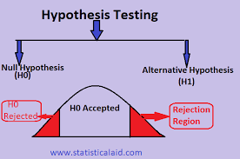
What is Hypothesis Testing?
Hypothesis testing evaluates claims about population parameters.
Null hypothesis (H₀):
No effect or no relationship
Alternative hypothesis (H₁):
An effect or relationship exists
Example:
H₀: BMI is not associated with hypertension
H₁: BMI is associated with hypertension

Slide 6
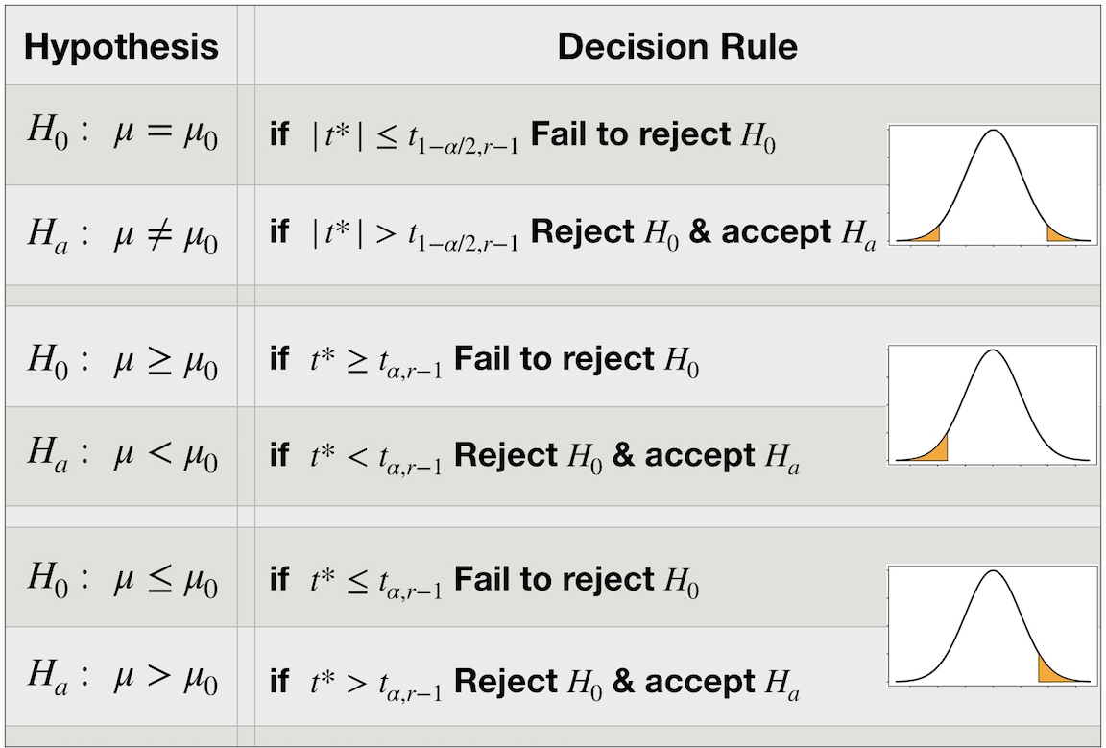
Decision Rule in Hypothesis Testing
Decision based on p-value:
p < 0.05 → Reject H₀
p ≥ 0.05 → Fail to reject H₀
Important principle:
We do not "accept" the null hypothesis.
We only reject or fail to reject it.

Slide 7
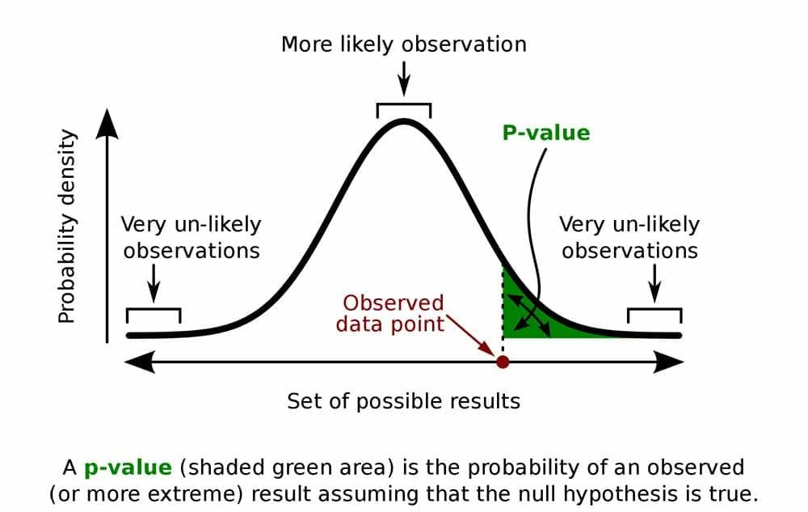
Understanding p-values
A p-value measures evidence against the null hypothesis.
Definition:
Probability of observing the data (or more extreme)
assuming the null hypothesis is true.
Interpretation:
Small p-value → Strong evidence against H₀
Large p-value → Weak evidence against H₀

Slide 8
Medical Example of a p-value
Hypothesis:
H₀: Mean SBP is equal in urban and rural clinics
H₁: Mean SBP differs between clinics
Result:
p = 0.003
p-value is compared with alpha (5% (0.05), 10%(0.1), 1%(0.01)
Interpretation:
There is strong evidence that clinic location is associated with systolic blood pressure.

Slide 9
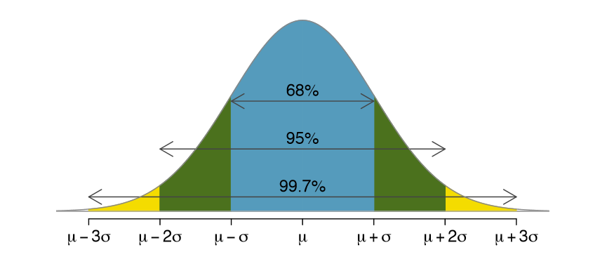
Confidence Interval
A confidence interval provides a range of plausible values for a population parameter.
95% confidence interval:
If the study were repeated many times, 95% of such intervals would contain the true value.
Confidence intervals show:
Effect size
Precision of estimates

Slide 10
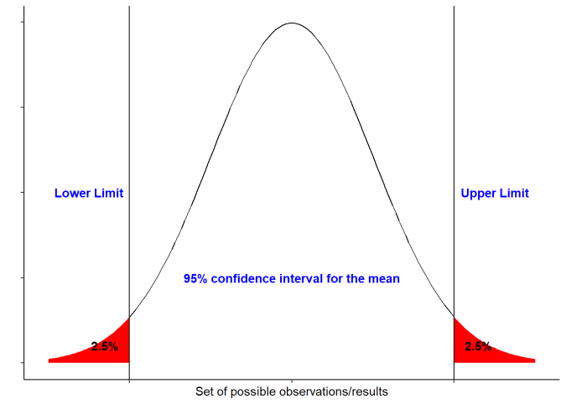
Confidence Interval Example
Mean SBP difference (urban – rural) = 4.2 mmHg
95% CI: [2.1, 6.3] mmHg
Interpretation:
The true SBP difference lies within this range
CI does not include zero → statistically significant
Provides more information than p-value alone

Slide 11
Choosing the Right Statistical Test
Test selection depends on variable types:
Two means → Independent t-test
More than two means → ANOVA
Two categorical variables → Chi-square test
Two continuous variables → Correlation
Continuous outcome → OLS regression
Binary outcome → Logistic regression

Slide 12
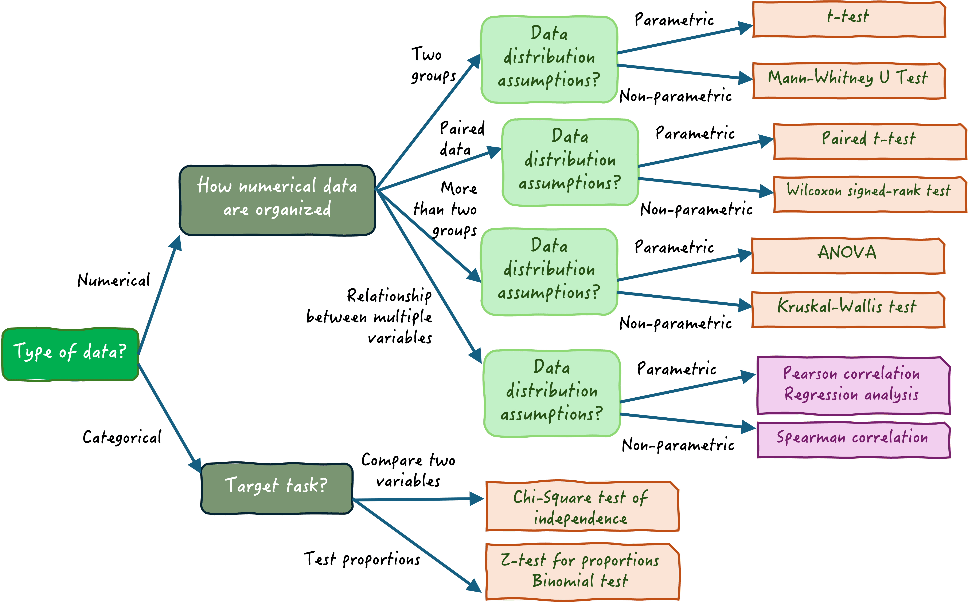

Slide 13
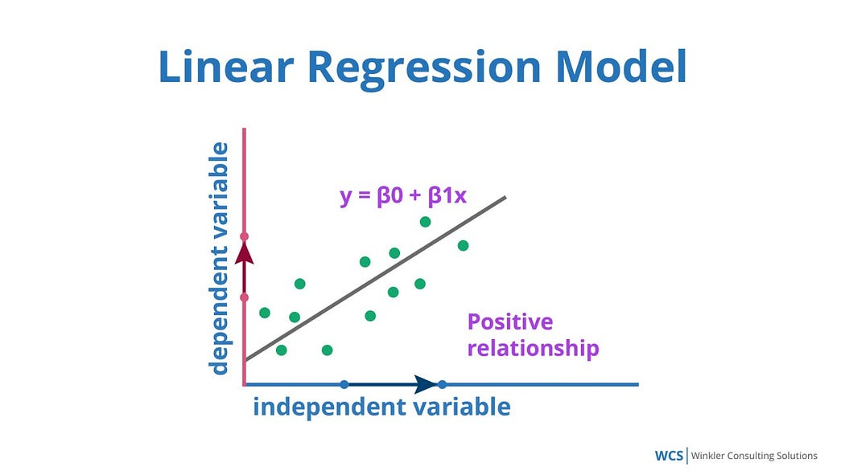
Introduction to Regression Analysis
Regression models the relationship between predictors (X) and an outcome variable (Y).
General form:
Y = β₀ + β₁X₁ + β₂X₂ + ... + ε
Regression is the foundation of many ML algorithms.

Slide 14
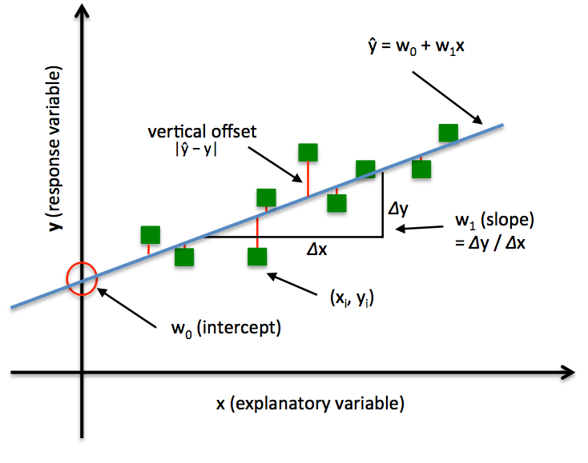
Ordinary Least Squares (OLS) Regression
OLS regression predicts continuous outcomes.
Medical application:
Predict systolic blood pressure using:
BMI
Age
Gender
OLS minimizes the sum of squared prediction errors.

Slide 15
Interpreting OLS Coefficients
Coefficient interpretation:
Sign (+/–): Direction of relationship
Magnitude: Size of effect
p-value: Statistical significance
Example:
A BMI coefficient of 0.87 means SBP increases by 0.87 mmHg per unit BMI increase, holding other variables constant.

Slide 16
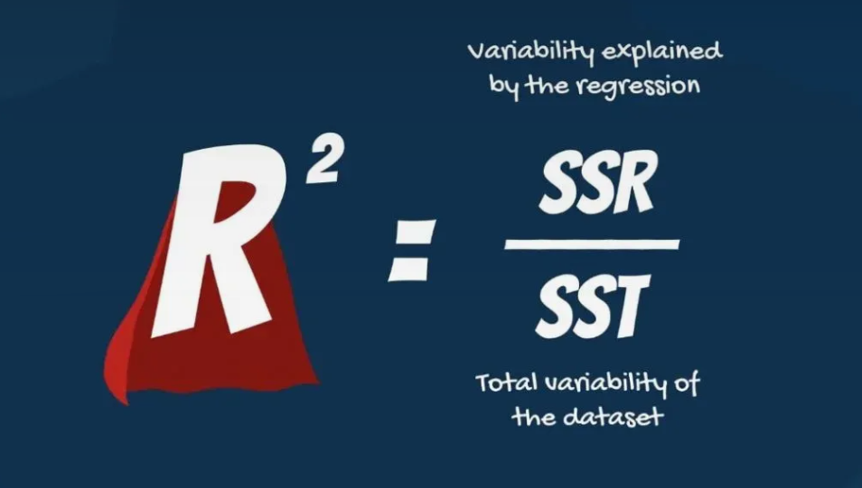
Model Fit in OLS Regression
Key evaluation metrics:
R²: Proportion of variance explained
RMSE: Prediction error magnitude
MAE: Average absolute error
R² does not imply causation, only explanatory power.

Slide 17
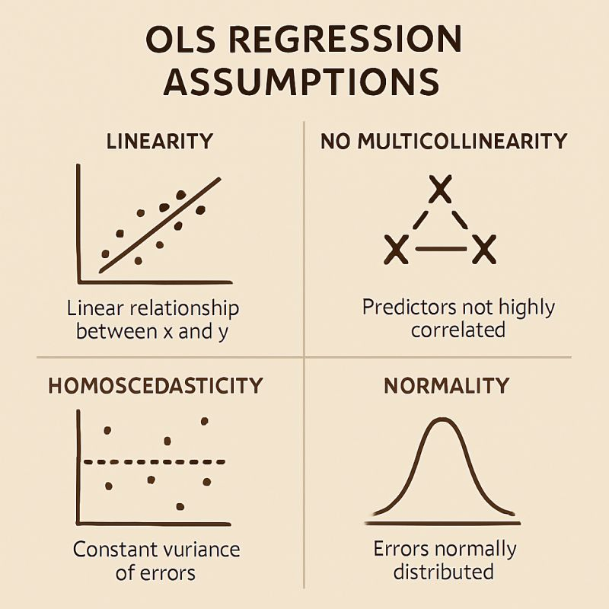
OLS Assumptions
OLS regression assumptions:
1. Linearity
2. Independence of observations
3. Homoscedasticity
4. Normality of residuals
5. No multicollinearity
Violations require transformations or alternative modeling approaches.

Slide 18
Logistic Regression Analysis

Slide 19
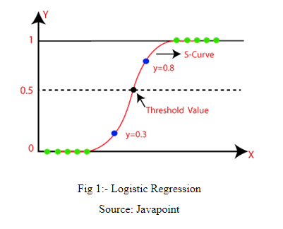
Logistic Regression
Logistic regression is used when the outcome is binary.
Medical application:
Predict hypertension (yes/no)
Logistic regression models log-odds, not probabilities directly.

Slide 20
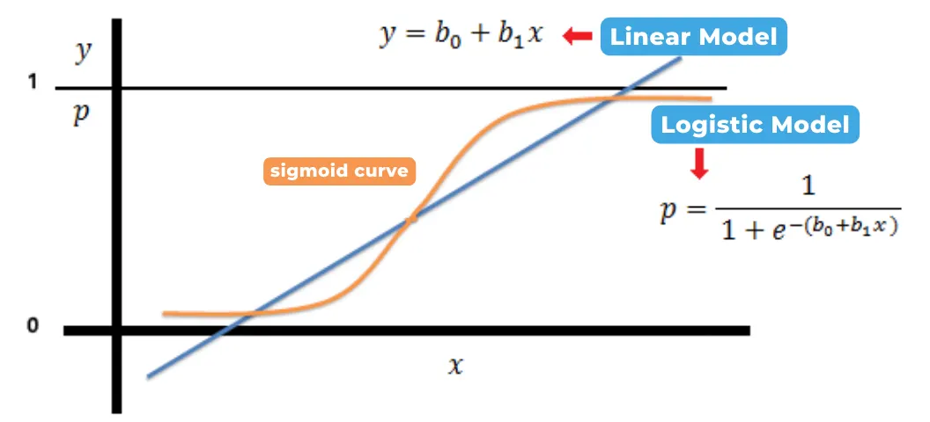
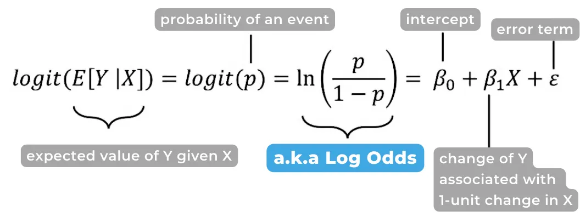
Logistic Regression Equation
Logit model:
log(p / (1 – p)) = β₀ + β₁X₁ + β₂X₂ + ...
Where:
p = probability of the event occurring
This ensures predictions lie between 0 and 1.

Slide 21
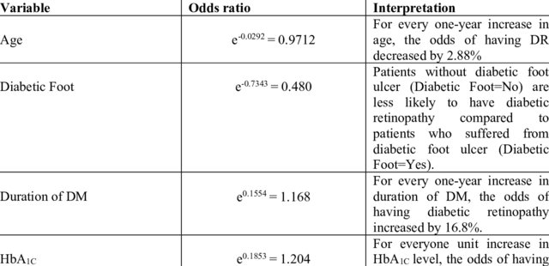
Interpreting Logistic Regression Results
Two interpretations:
Coefficients → Change in log-odds
Odds ratios (e^β) → Multiplicative change in odds
Odds ratio > 1 → Increased odds
Odds ratio < 1 → Decreased odds

Slide 22
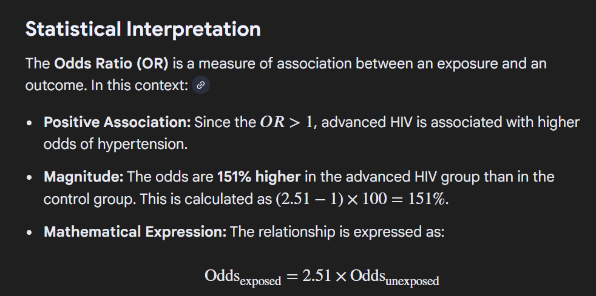
Logistic Regression Example
Advanced HIV status:
Odds ratio = 2.51
Interpretation:
Patients with advanced HIV have 2.5 times higher odds of hypertension compared to others.

Slide 23
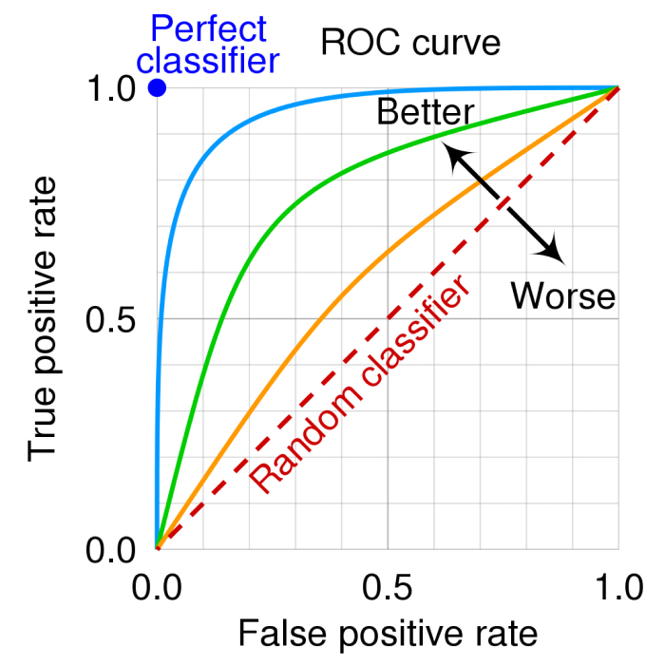
Model Evaluation for Classification
Key metrics for binary outcomes:
Accuracy
Sensitivity (Recall)
Specificity
AUC–ROC
Medical screening prioritize high sensitivity to reduce missed cases.

Slide 24
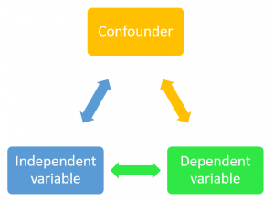
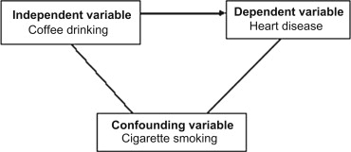
Confounding and Adjustment
Confounding occurs when a third variable distorts the relationship between X and Y.
Example:
Urban clinics appear associated with higher SBP, but age explains the difference.
Solution:
Multivariable regression adjustment.

Slide 25
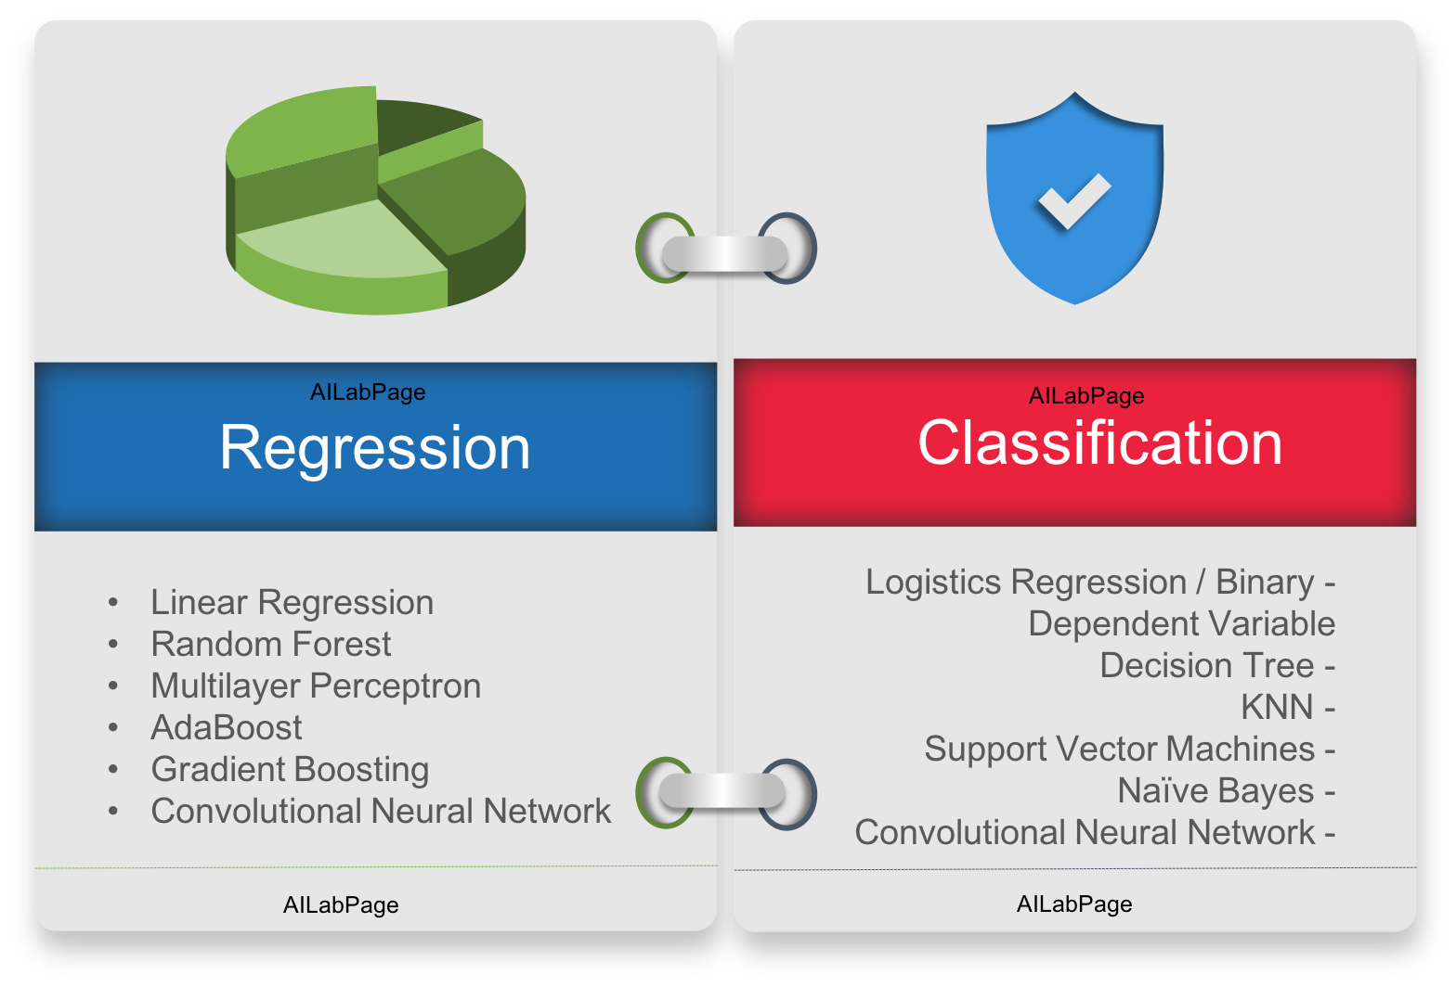
Regression as Machine Learning
Regression models are machine learning algorithms.
Connections:
Linear regression → Linear ML model
Logistic regression → Classification ML model
Neural networks → Stacked regression layers
Understanding regression enables ML mastery.

Slide 26
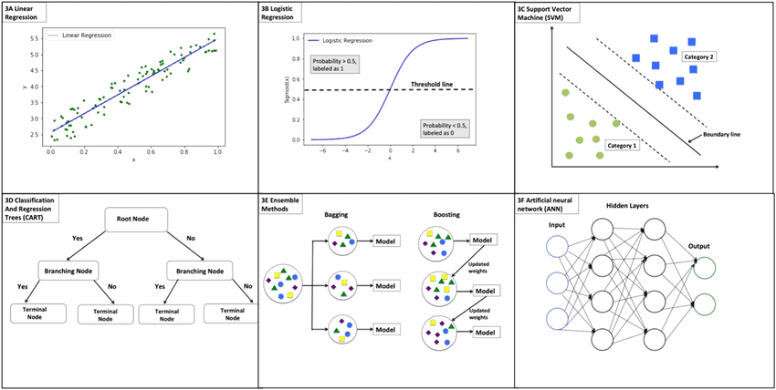
Regression as Machine Learning

Slide 27

Common Statistical Pitfall
Avoid these errors:
Data leakage
P-hacking
Ignoring confounding
Overfitting models
Statistical rigor protects patient safety and model credibility.

Slide 28
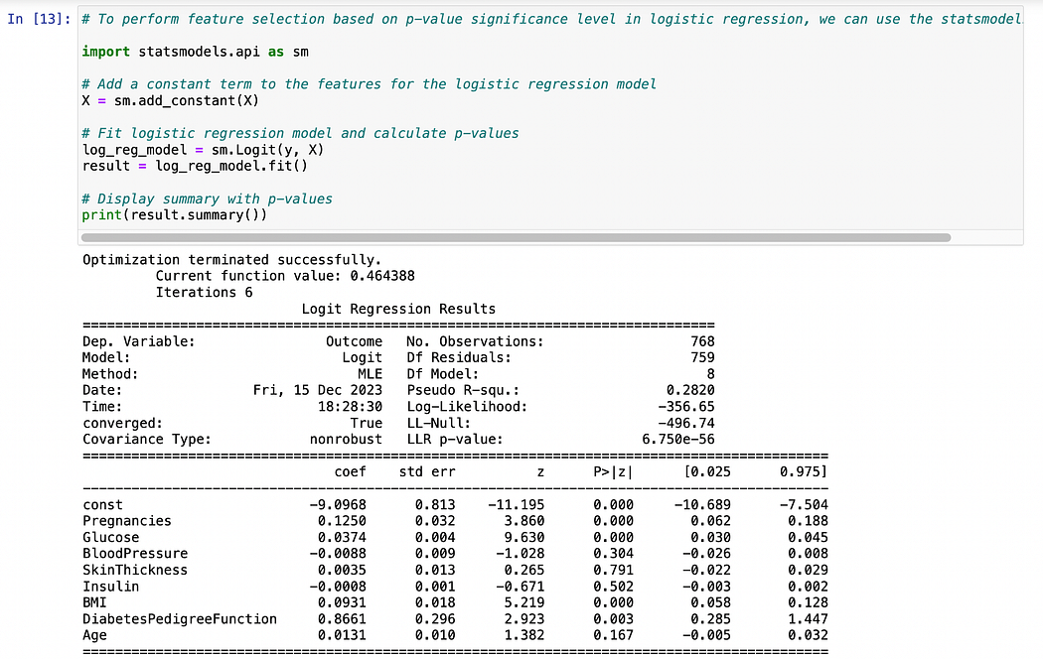
Lab Assignment Overview
Tasks:
Hypothesis testing
OLS regression for SBP
Logistic regression for hypertension
Model evaluation and interpretation
Deliverable:
Python notebook (.ipynb)

Slide 29
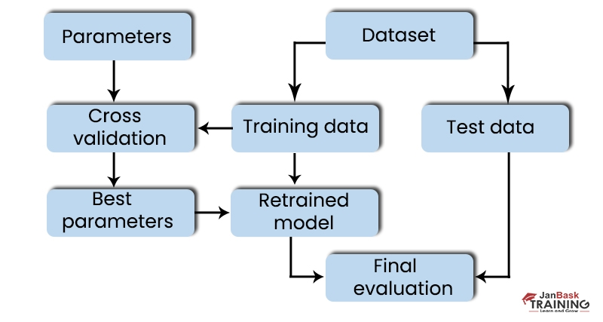
Python Analysis Workflow
Steps:
Load and clean data
Conduct hypothesis tests
Fit OLS regression
Fit logistic regression
Evaluate model performance

Slide 30
Preparing for Week 3 Machine Learning
Before next session:
Complete lab assignment
Review regression concepts
Understand train-test split
Install required Python libraries
Week 3 focuses on scalable ML pipelines.

Slide 31
Conclusion
Key takeaways:
Hypothesis testing guides evidence-based decisions
Regression underpins machine learning algorithms
Statistical literacy enables responsible AI
Healthcare ML requires precision and ethics
Statistics is the foundation of trustworthy machine learning.

